Slide 1


Design Pattern
IT대학 컴퓨터학부
이우진

Slide 2
Design Patterns
Need effective design crucial for large programs
Design patterns
Proven architectures for developing object-oriented software
Architectures created from accumulated industry experience
Reduce design-process complexity
Promotes design reuse in future systems
Helps identify common design mistakes and pitfalls
Helps design independently of implementation language
Establishes common design “vocabulary”
Shortens design phase in software-development process

Slide 3
Design Patterns (cont.)
History of Design Patterns
Gamma, Helm, Johnson and Vlissides
“Gang of Four”
Design Patterns, Elements of Reusable Object-Oriented Software (Addison Wesley: 1995)
Established 23 design patterns
Creational
Instantiate objects
Structural
Organize classes and objects
Behavioral
Assign responsibilities to objects

Slide 4
Catalog of Design Patterns
 |  | Purpose
 |  | Creational | Structural | Behavioral
Scope | Class | Factory Method | Adapter(Class) | Interpreter Template Method
 | Object | Abstract Factory Builder Prototype Singleton | Adapter(Object) Bridge Composite Decorator Facade Flyweight Proxy | Chain of Responsibility Command Iterator Mediator Memento Observer State Strategy Visitor

Slide 5
인터페이스 관점의 상속
상속을 통한 내부 은폐
클라이언트에게 Parent 클래스만 보이게 하여 내부의 복잡한 상황들을 숨김
서브 시스템간의 커뮤니케이션에 많이 이용됨
Client
Class
Parent
Class
Child
Class A
Child
Class B
Notes:
Client class : 조명 -> clas 조명(){ public ISW sw; 조명(sw){}
Parent class : Interface isw{ on(), off()}
Child class A : switch{ public void on() public void off()}
Child class B가 없어도 client class는 인터페이스를 통해서 사용 가능하다 -> 상속을 통해 내부 은폐(서버 시스템 커뮤니케이션에서 많이 사용됨)

Slide 6
상속을 통한 재귀적 구조 정의
재귀적 구조 관계를 상속으로 정의함
디렉토리는 파일의 일종이다.
디렉토리는 파일들을 포함한다.
디렉토리는 서브디렉토리를 포함한다.
File
0..*
File
0..*
단순화
1
2
Directory
Directory
0..*
3
Notes:
많이 나오는 구조
File도 파일이지만 directory도 파일이다
Directory는 파일들을 여러 개 가지고있다. Directory는 director를 가질 수 있다. (근데 파일이 디렉토리이니까 굳이 디렉토리에서 재귀적으로 구조 할 필요가 없다)

Slide 7
인터페이스 관점의 상속 2
상속을 통한 내부의 복잡한 구조를 은폐
클라이언트에게 모두 File 클래스로만 인지되며 내부의 복잡한 재귀적 정의는 숨겨짐
Client
Class
File
0..*
Text
File
…
Directory
Notes:
Client가 파일을 가지고 작업하는데 file은 text file 이거나 director인데 directory는 파일을 여러 개 가질 수 있다.

Slide 8
Creational Design Pattern
Singleton
Prototype

Slide 9
Creational – Singleton I
Intent
Ensure a class has only one instance and provide a global point of access.
Solution:
Declare the constructor(s) as Protected;
Declare a static “self” pointer to hold a reference to the single instance when it is created;
Declare a static “instance” function which creates and returns the single instance if the self pointer is NULL, otherwise it just returns the previously created instance.
Declare a protected destructor that sets the “self” pointer to NULL
Declare other methods and attributes as needed normally.
Clients access the singleton by calling the static instance function to get a reference to the single instance and then using it to call other methods.
Clients must not store this instance reference -- Each code segment that needs to access the singleton should call the instance function, perform the work needed and then discard the reference as quickly as possible.
Notes:
Class Some{
….
static private Some t;
private or protect 생성자; (-> 밖에서 s= new Some() 이게 안됨)
get....();
}
Some s = new Some();
Some t = new Some();
Class를 정의했는데 유일하게 instance가 하나만 만들고 싶을때의 패턴 : singleton

Slide 10
Creational – Singleton II
Consequences
Insures that only one instance of the class can ever be created.
Access to the sole instance is strictly controlled by the object itself.
Singleton classes may be extended by subclassing. Code written to use the base singleton class will automatically use an instance of the subclass provided that the instance function of the subclass is called by the client code prior to any call to the base singleton class’ instance function.
Reduces the number of global names defined in a system. Singletons avoid polluting the name space with global variables.
More flexible than using class (static) methods for functionality, since static functions (in C++) cannot be polymorphically overridden by subclasses.

Slide 11
Creational – Singleton III
if (self is NULL) self = new Singleton return self
Singleton
$self : Singleton * someData
$instance() doOperation()
Client
aMethod()
. . . Singleton::instance()->doOperation() . . .
Notes:
&self : Singleton* -> 자기 자신을 가지는 변수
New는 외부에서 접근 못함(private) 내부에서 접근해야함($instance())

Slide 12
Creational – Singleton IV
Sample Code
class MazeFactory {
public:
static MazeFactory* Instance();
// existing interface goes here
protected:
MazeFactory();
private:
static MazeFactory* _instance;
};
MazeFactory* MazeFactory::_instance = 0;
MazeFactory* MazeFactory::Instance () {
if (_instance == 0) {
_instance = new MazeFactory;
}
return _instance;
}
Notes:
프린터 스캐너 같은 장치 관련 클래스의 인스턴스는 1개만 존재
인스턴스가 1개만 존재하는 클래스를 만드는 방법
멀티쓰레드 환경에서 두개 발생가능함
Static 변수와 metho를 이용하여 해결하면 상속이 않됨
싱글톤 패턴은 상속 가능
그래도 결국은 global 변수 형국이니 사용 시 조심필요
세계에서 유일한 클래스
MazeFactory.instance(); 로 호출 가능

Slide 13
Creational – Prototype I
Intent
Specify the kinds of objects to create using a prototypical instance, and create new objects by copying this prototype.
Motivation
In the framework of graphical editors, when dragging the icon of palette, the corresponding object should be instantiated without knowing the type of object.
In order to customize the graphical editors, new icons should be added into the palette.
Applicability
when the classes to instantiate are specified at run-time
to avoid building a class hierarchy of factories that parallels the class hierarchy of products
when instances of a class can have one of only a few different combinations of state. It may be more convenient to install a corresponding number of prototype and clone them
Notes:
객체를 복사하여 객체를 생성한다…. 춘향이 닮은 여자를 데려와라 !!
트리 구조 생각하기

Slide 14
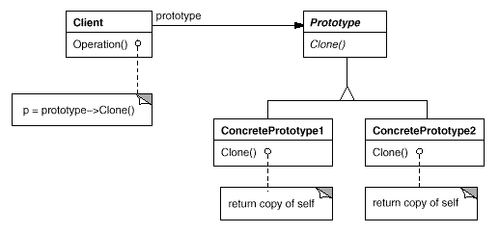
Creational – Prototype II
Structure
Notes:
Class tree(){
node
node
clone();
}

Slide 15
Creational – Prototype III
Consequences
It hides the concrete product classes from the client, thereby reducing the number of names clients know about.
Adding and removing products at run-time.
Specifying new objects by varying values.
Specifying new objects by varying structure.
Reduced subclassing. Factory Method often produces a hierarchy of Creator classes that parallels the product class hierarchy. The Prototype pattern lets you clone a prototype instead of asking a factory method to make a new object.
Configuring an application with classes dynamically.
Notes:
클래스의 concrete product를 사용자에게 숨긴다.
팩토리에서 생성될 때 보다 적은 정보를 이용하여 생성할 수 있다.
실제 제품이 굉장히 복잡해서
Deep copy를 해주는 패턴

Slide 16
Creational – Prototype IV
Sample Code
class Door : public MapSite {
public:
Door();
Door(const Door&);
virtual void Initialize(Room*, Room*);
virtual Door* Clone() const;
virtual void Enter();
Room* OtherSideFrom(Room*);
private:
Room* _room1;
Room* _room2;
};
Door::Door (const Door& other) {
_room1 = other._room1;
_room2 = other._room2;
}
void Door::Initialize (Room* r1, Room* r2) {
_room1 = r1;
_room2 = r2;
}
Door* Door::Clone () const {
return new Door(*this);
}
class BombedWall : public Wall {
public:
BombedWall();
BombedWall(const BombedWall&);
virtual Wall* Clone() const;
bool HasBomb();
private:
bool _bomb;
};
BombedWall::BombedWall (const BombedWall& other):Wall(other)
{
_bomb = other._bomb;
}
Wall* BombedWall::Clone () const {
return new BombedWall(*this);
}
ConcretePrototype1
ConcretePrototype2

Slide 17
Creational – Prototype IV
Sample Code
Client
<Abstract Factory Code>
class MazePrototypeFactory : public MazeFactory {
public:
MazePrototypeFactory(Maze*, Wall*, Room*, Door*);
virtual Maze* MakeMaze() const;
virtual Room* MakeRoom(int) const;
virtual Wall* MakeWall() const;
virtual Door* MakeDoor(Room*, Room*) const;
private:
Maze* _prototypeMaze;
Room* _prototypeRoom;
Wall* _prototypeWall;
Door* _prototypeDoor;
};
Wall* MazePrototypeFactory::MakeWall () const {
return _prototypeWall->Clone();
}
Door* MazePrototypeFactory::MakeDoor (Room* r1, Room *r2) const {
Door* door = _prototypeDoor->Clone();
door->Initialize(r1, r2);
return door;
}
class MazeFactory {
public:
MazeFactory();
virtual Maze* MakeMaze() const
{ return new Maze; }
virtual Wall* MakeWall() const
{ return new Wall; }
virtual Room* MakeRoom(int n) const
{ return new Room(n); }
virtual Door* MakeDoor(Room* r1, Room* r2) const
{ return new Door(r1, r2); }
};
class EnchantedMazeFactory : public MazeFactory {
public:
EnchantedMazeFactory();
virtual Room* MakeRoom(int n) const
{ return new EnchantedRoom(n, CastSpell()); }
virtual Door* MakeDoor(Room* r1, Room* r2) const
{ return new DoorNeedingSpell(r1, r2); }
protected:
Spell* CastSpell() const;
};

Slide 18
Structural Design Pattern
Façade
Adapter
Composite
Decorator

Slide 19
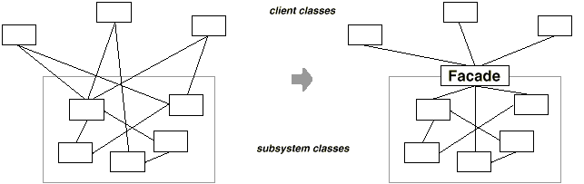
Structural – Façade I
Intent
Provide a unified interface to a set of interfaces in a subsystem.
Facade defines a higher-level interface that makes the subsystem easier to use.
Motivation
Structuring a system into subsystems helps reduce complexity.
A common design goal is to minimize the communication and dependencies between subsystems.
One way to achieve this goal is to introduce a facade object that provides a single, simplified interface to the more general facilities of a subsystem.
Notes:
영화보기 → tv on/ amp on/ dvd on/ tv aux 선택/ amp dvd 선택/ tv 소리 최소/ amp 소리 조절/ dvd play
복잡한 과정을 façade의 영화보기()에서 모두 수행해버립니다.

Slide 20
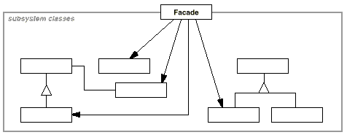
Structural – Façade II
Structure

Slide 21
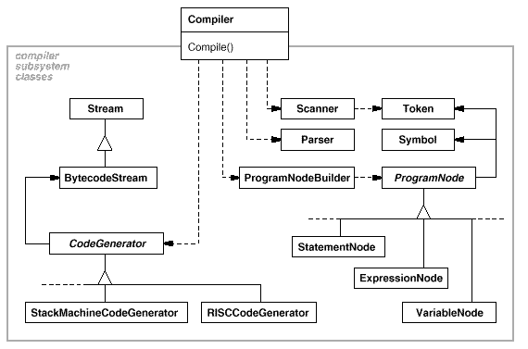
Structural – Façade III
Applying Façade pattern to a programming environment example

Slide 22
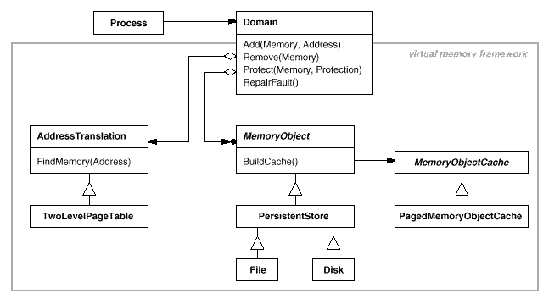
Structural – Façade IV
Applying Façade pattern to the virtual memory framework

Slide 23
Structural – Adapter I
Intent
Convert the interface of a class into another interface clients expect.
Adapter lets classes work together that couldn't otherwise because of incompatible interfaces.
Notes:
인터페이스 변환

Slide 24
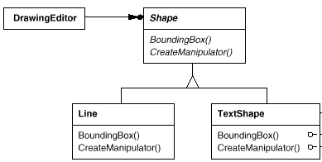

Structural – Adapter II
Motivation
Consider a drawing editor that lets users draw and arrange graphical elements (lines, polygons, text, etc) into pictures and diagrams.
Abstract class Shape is used as the interface for graphical objects such as LineShape, PolygonShape, and so on.
A sophisticated TextView class is provided by off-the-shelf user interface toolkit.
How can existing and unrelated classes like TextView work in an application that expects classes with a different and incompatible interface ?
PolygonShape

Slide 25
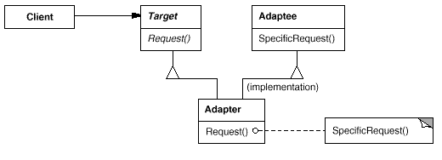
Structural – Adapter III
Structure I
A class adapter uses multiple inheritance to adapt one interface to another

Slide 26
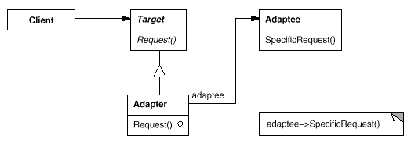
Structural – Adapter IV
Structure II
An object adapter relies on object composition

Slide 27
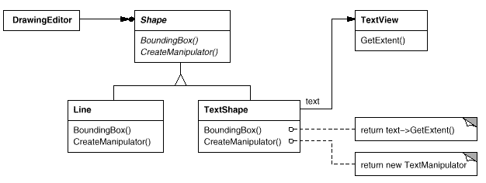
Structural – Adapter V
Applying Adapter pattern to the drawing editor example

Slide 28
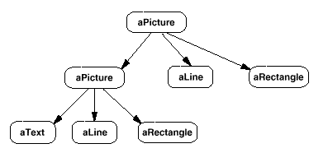
Structural – Composite I
Intent
Compose objects into tree structures to represent part-whole hierarchies.
Composite lets clients treat individual objects and compositions of objects uniformly.
Motivation
Graphics applications like drawing editors and schematic capture systems let users build complex diagrams out of simple components.
The user can group components to form larger components, which in turn can be grouped to form still larger components.
A simple implementation could define classes for graphical primitives such as Text and Lines plus other classes that act as containers for these primitives.
Code that uses these classes must treat
primitive and container objects
differently, even if most of the time
the user treats them identically.

Slide 29
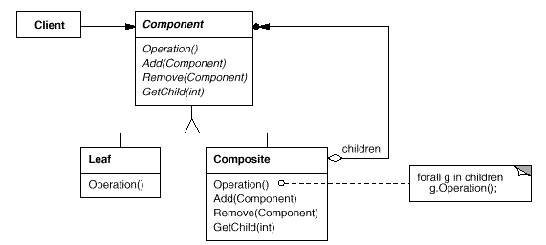
Structural – Composite II
Structure

Slide 30
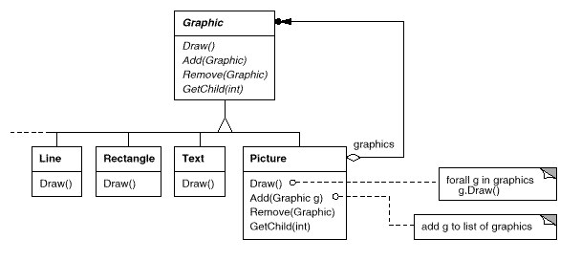
Structural – Composite III
Applying Composite pattern to the Graphics application

Slide 31
Structural – Composite VI
Sample Code I
class Equipment {
public:
virtual ~Equipment();
const char* Name() { return _name; }
virtual Watt Power();
virtual Currency NetPrice();
virtual Currency DiscountPrice();
virtual void Add(Equipment*);
virtual void Remove(Equipment*);
virtual Iterator* CreateIterator();
protected:
Equipment(const char*);
private:
const char* _name;
};
class FloppyDisk : public Equipment {
public:
FloppyDisk(const char*);
virtual ~FloppyDisk();
virtual Watt Power();
virtual Currency NetPrice();
virtual Currency DiscountPrice();
};

Slide 32
Structural – Composite V
Sample Code II
Currency CompositeEquipment::NetPrice () {
Iterator* i = CreateIterator();
Currency total = 0;
for (i->First(); !i->IsDone(); i->Next()) {
total += i->CurrentItem()->NetPrice();
}
delete i;
return total;
}
class CompositeEquipment : public Equipment {
public:
virtual ~CompositeEquipment();
virtual Watt Power();
virtual Currency NetPrice();
virtual Currency DiscountPrice();
virtual void Add(Equipment*);
virtual void Remove(Equipment*);
virtual Iterator* CreateIterator();
protected:
CompositeEquipment(const char*);
private:
List<Equipment*> _equipment;
};
class Chassis : public CompositeEquipment {
public:
Chassis(const char*);
virtual ~Chassis();
virtual Watt Power();
virtual Currency NetPrice();
virtual Currency DiscountPrice();
};

Slide 33
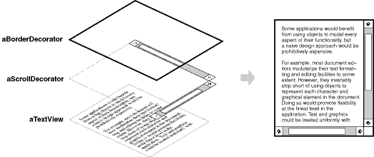
Structural – Decorator I
Intent
Attach additional responsibilities to an object dynamically.
Decorators provide a flexible alternative to subclassing for extending functionality.
Motivation
A graphical user interface toolkit, for example, should let you add properties like borders or behaviors like scrolling to any user interface component.
One way to add responsibilities is with inheritance. Inheriting a border from another class puts a border around every subclass instance.
A more flexible approach is to enclose the component in another object that adds the border.

Slide 34
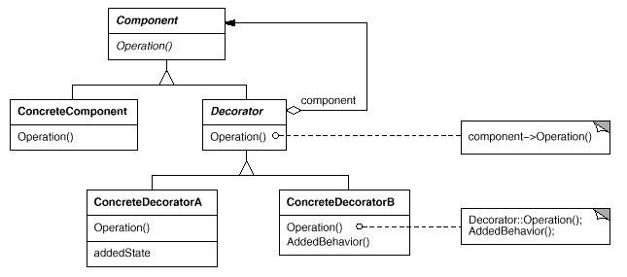
Structural – Decorator II
Structure

Slide 35
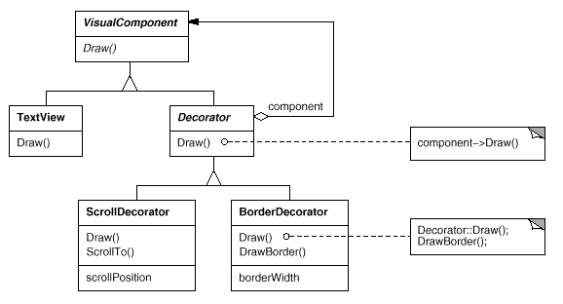
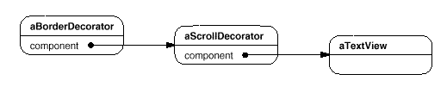
Structural – Decorator III
Applying Decorator pattern to the Graphical user interface toolkit example

Slide 36
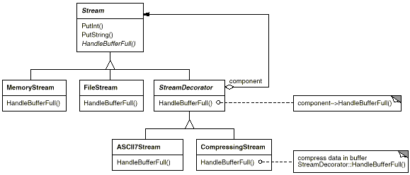
Structural – Decorator IV
Applying Decorator pattern to the stream example

Slide 37
Structural – Decorator V
Sample Code
class VisualComponent {
public:
VisualComponent();
virtual void Draw();
virtual void Resize();
// ...
};
class BorderDecorator : public Decorator {
public:
BorderDecorator(VisualComponent*, int borderWidth);
virtual void Draw();
private:
void DrawBorder(int);
private:
int _width;
};
void BorderDecorator::Draw () {
Decorator::Draw();
DrawBorder(_width);
}
class Decorator : public VisualComponent {
public:
Decorator(VisualComponent*);
virtual void Draw();
virtual void Resize();
// ...
private:
VisualComponent* _component;
};
void Decorator::Draw () { _component->Draw(); }
void Decorator::Resize () { _component-Resize(); }

Slide 38
Behavioral Design Pattern
Template Method
Iterator
Observer

Slide 39
Behavioral – Template Method I
Intent
Define the skeleton of an algorithm in an operation, deferring some steps to subclasses. Template Method lets subclasses redefine certain steps of an algorithm without changing the algorithm's structure.
Applicability
to implement the invariant parts of an algorithm once and leave it up to subclasses to implement the behavior that can vary.
when common behavior among subclasses should be factored and localized in a common class to avoid code duplication.
to control subclasses extensions. You can define a template method that calls "hook" operations at specific points, thereby permitting extensions only at those points.

Slide 40
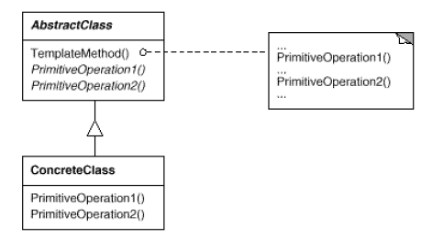
Behavioral – Template Method II

Slide 41
Behavioral – Iterator I
Intent
Provide a way to access the elements of an aggregate object sequentially without exposing its underlying representation.
Applicability
to access an aggregate object's contents without exposing its internal representation.
to support multiple traversals of aggregate objects.
to provide a uniform interface for traversing different aggregate structures (that is, to support polymorphic iteration)

Slide 42
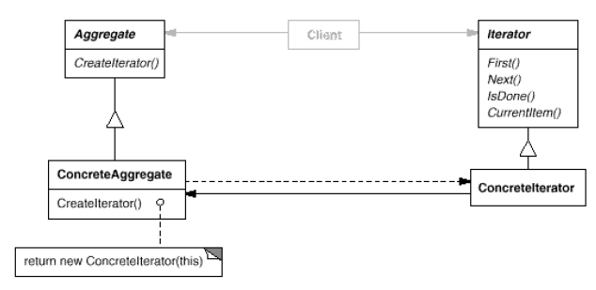
Behavioral – Iterator II
The key idea in this pattern is to take the responsibility for access and traversal out of the Aggregate object and put it into an iterator object.

Slide 43
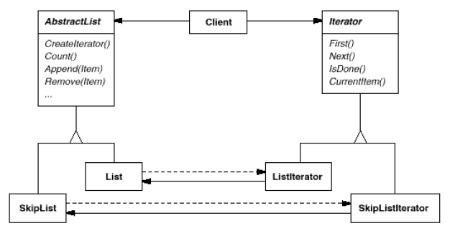
Behavioral – Iterator III
Let's assume that we also have a SkipList implementation of a list. A skiplist is a probabilistic data structure with characteristics similar to balanced trees.

Slide 44
Behavioral – Observer I
Intent
Define relationship between a group of objects such that whenever one object is updated all others are notified automatically.
Applicability
Changes to one object in a group requires changes to the others in the group
The number of objects in the group may vary
Loose coupling is desired between the objects in the group
Consequences
Subjects have limited knowledge of the objects in the observed group
Objects may easily be added or removed without changing existing objects
Update notifications are automatically broadcast to all interested objects
The cost of updating any object in the group may be greater than expected
Update notifications may occur more frequently than desired or expected

Slide 45
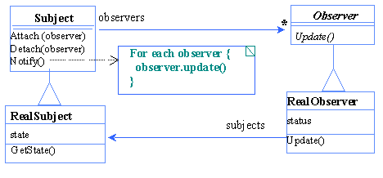
Behavioral – Observer II

Slide 46
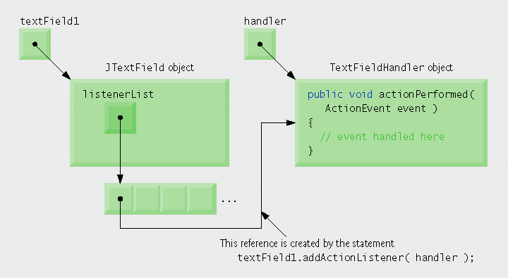
Java GUI 수행 매카니즘
Every JComponent has instance variable listenerList
Object of type EventListenerList
Maintains references to all its registered listeners
Events are dispatched to only the event listeners that match the event type
Events have a unique event ID specifying the event type

Slide 47
Java GUI Example

